Slide 1

Creating Playlists Based on Clustered Songs from a User’s Streaming History
Jake Darby

Slide 2
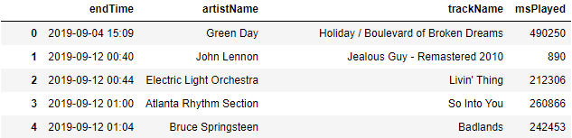
My data:
I requested my Spotify streaming history from Spotify and received a csv file which is shown below in a dataframe using Pandas.
I want to make playlists from clustered songs, but I need more than just the date, artist, title, and time played.

Slide 3
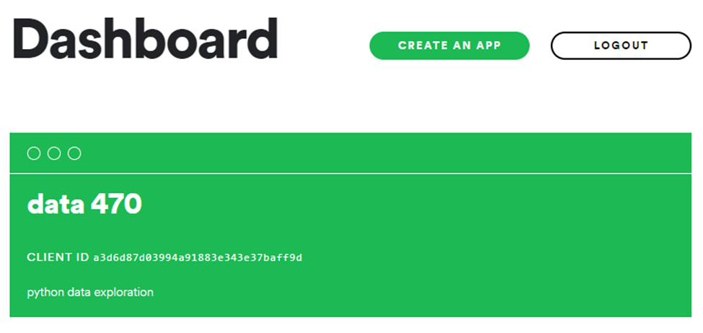
Spotify Developer Page

Slide 4
Attributes of Songs
Attribute | Description
Acousticness | A confidence measure from 0.0 to 1.0 of whether the track is acoustic. 1.0 represents high confidence the track is acoustic.
Danceability | Danceability describes how suitable a track is for dancing based on a combination of musical elements including tempo, rhythm stability, beat strength, and overall regularity. A value of 0.0 is least danceable and 1.0 is most danceable.
Energy | Energy is a measure from 0.0 to 1.0 and represents a perceptual measure of intensity and activity. Typically, energetic tracks feel fast, loud, and noisy.
Instrumentalness | Predicts whether a track contains no vocals. The closer the instrumentalness value is to 1.0, the greater likelihood the track contains no vocal content, where anything over 0.5 can be considered instrumental.
Liveness | Detects the presence of an audience in the recording. Higher liveness values represent an increased probability that the track was performed live.
Loudness | The overall loudness of a track in decibels (dB). Values typical range between -60 and 0 db.
Popularity | A measure of an artist’s popularity on Spotify, ranging from a scale from 0 to 100, from least to most popular.
Speechiness | Detects the presence of spoken words in a track. The more exclusively speech-like the recording (e.g. talk show, audio book, poetry), the closer to 1.0 the attribute value.
Tempo | The overall estimated tempo of a track in beats per minute (BPM).
The Spotify Web API allows me to obtain the attributes for all of my songs in my dataframe.

Slide 5
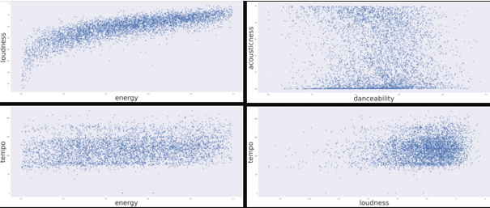
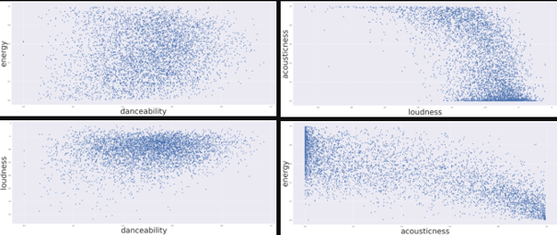
Scatterplots of the Song Attributes
Using Seaborns, I was able to plot the song attributes against each other to try to find correlations between them.

Slide 6
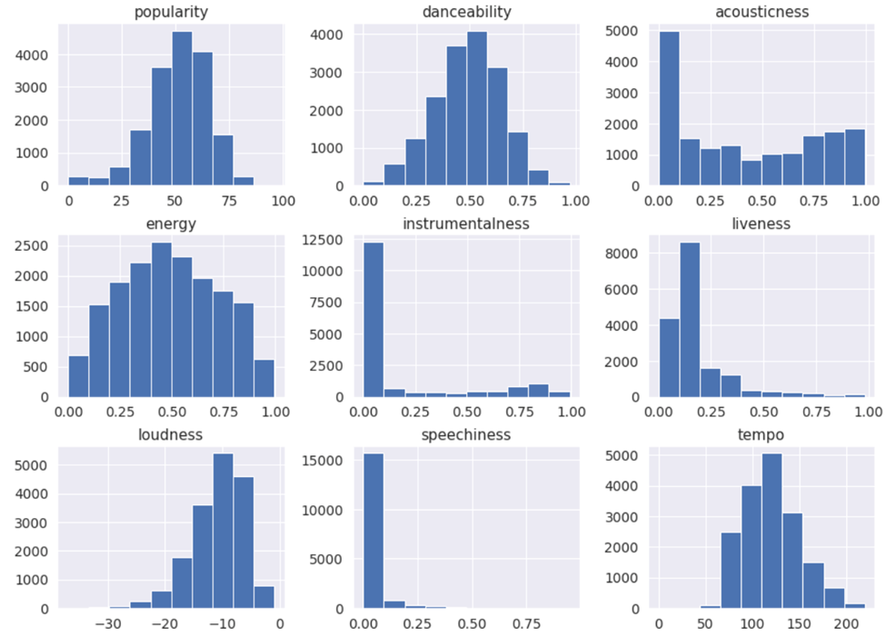
Visualizing Attribute Distribution
Using the histogram functions from Pandas, I can visualize the distribution of song attributes over the quantiles of my data.

Slide 7
Scaling and Clustering the Data
Because clusters are determined by how far apart points are between each other when plotted, it helps to set the attributes on a common scale in order to create an evenly balanced clustering, where no attribute becomes more important than another.
Now that my data are scaled, I need to determine how many clusters would be optimal for my data. To achieve this, I can utilize the “elbow method”, where, if the line chart resembles an arm, then the “elbow” (the point of inflection on the curve) is a good indication that the underlying model fits best at that point.

Slide 8
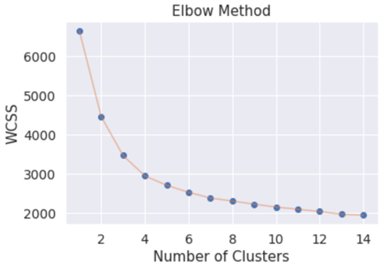
Scaling and Clustering the Data
WCSS is the sum of squares of the distances of each data point in all clusters to their respective centroids.
By the Elbow Method, I can now see that the best number of clusters to use for my project is 4.

Slide 9
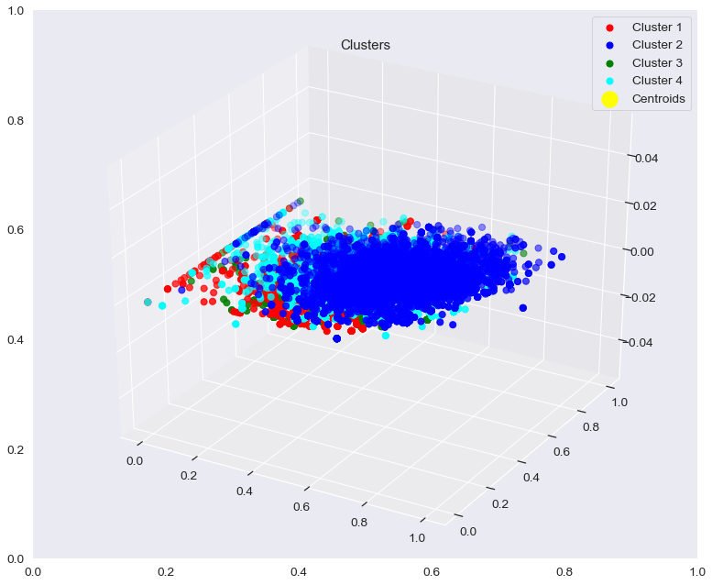
Creating/Visualizing My Clusters
Using Kmeans clustering from the SKLearn library, I create 3 clusters for my data.
Visual of my clusters:

Slide 10
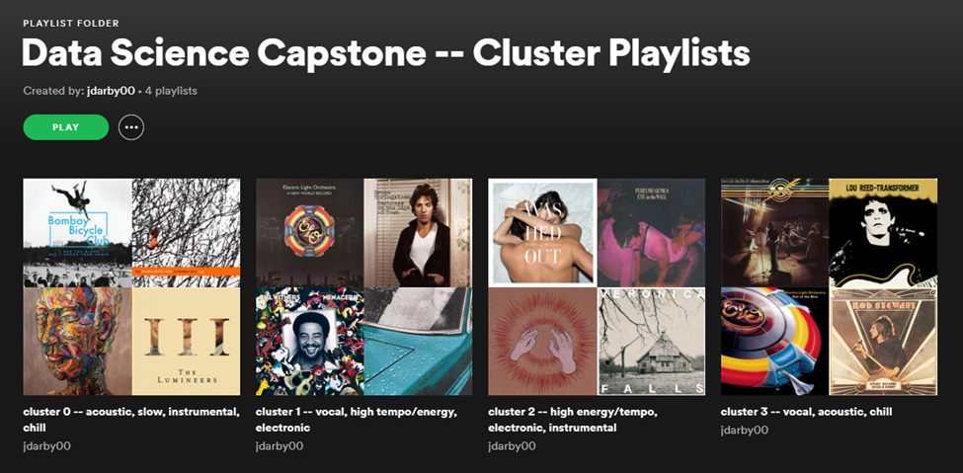
Transferring Clustered Songs to Spotify
Gaining authorization was tricky!

